Slide 1
WHAT IS STORY?
CJ Lyons
Thrillers with Heart®
CJLyons.net

Slide 2
SIX most POWERFUL words….

Slide 3
Let Me Tell You A STORY

Slide 4
Notes:
We all agree on power of story, but what IS story?

Slide 5
Story is…
Characters taking ACTION
Plot = Time
Decisions, Actions, Change over the TIME of the Plot reveal Truth of Character

Slide 6
Plotting 101
Opening
Call to action
Turning Point #1 = Decision
Midpoint = Everything Changes
Turning Point #2 = Retreat
Black Moment = Crisis
Climax = Change
Resolution
Notes:
3 act, five act, seven, eight, whatever works for you

Slide 7
3 Secrets:
Know Yourself
Know Your Reader
Know Your Story
Notes:
Many paths to get to where we want to go, so need a clear vision…it could be making money, then your path will be different, could be to delight and entertain readers, or to build a legacy…wherever your vision leads you, you need the tools to make the journey…
We’ll be focused on the last: know your story

Slide 8
Know Your Story
What’s it about = Core Idea
Premise, pitch, logline, high concept, theme…all stem from Core Idea

Slide 9
YOUR TURN!
Notes:
What’s your story about? Your core idea? Write it down—one sentence, the shorter the better... Share...

Slide 10
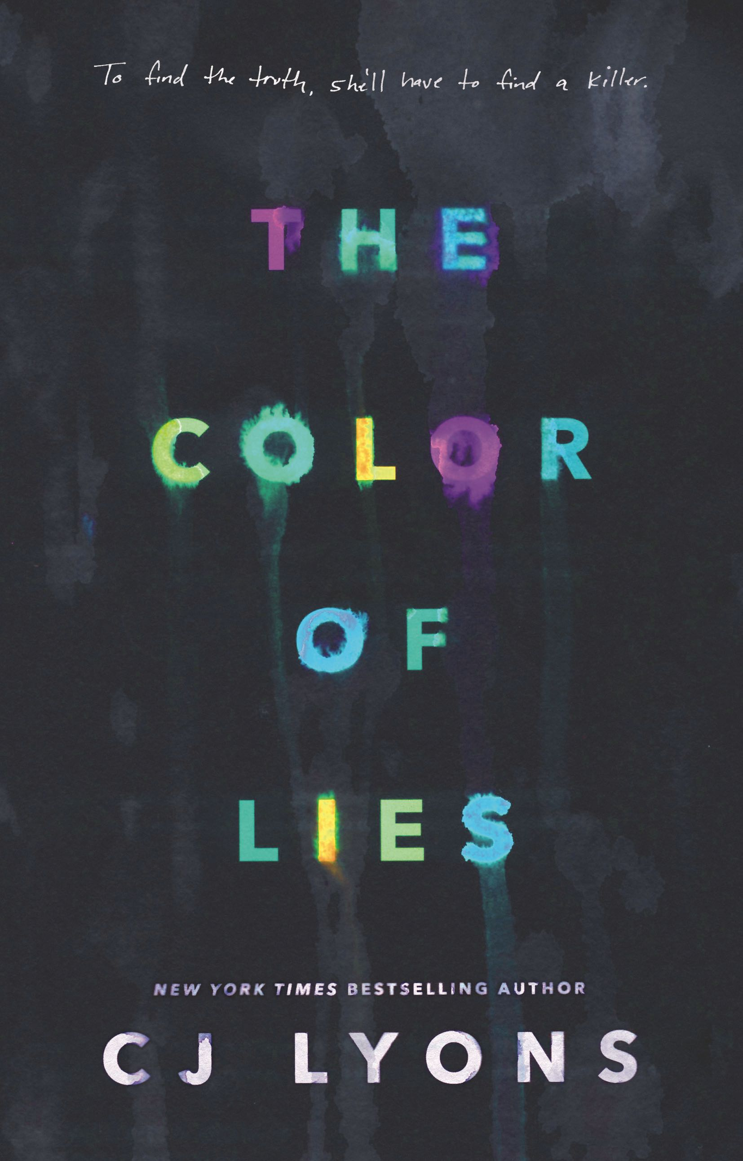
Notes:
Girl with synesthesia searches for truth behind her parents’ deaths...
Not snappy, clever, just boots on the ground to get started...

Slide 11
OPENING HOOKS
CJ Lyons
Thrillers with Heart®
CJLyons.net

Slide 12
5 second rule
What’s your promise to the reader? Reflects Theme
What do you want them to feel at the end of the story? Needs to be in the beginning
Microtension—comes from world building
Notes:
5 seconds to grab a reader—used to be 5 pages, but not today!

Slide 13
Theme
Intersection of Plot and Character
What your book is REALLY about
Universal, primal human experience
Focus, focus, focus…
Notes:
Indy Jones #2, Godfather
Theme focuses not just the writer's choice of which scenes to include in the plot but also it keeps the audience focused on an emotional level while all the special effects and action sequences are going on.

Slide 14
Why do we need it?
Turns plot’s action into…
DRAMA
Notes:
If someone says a story was compelling, it's because there was a strong theme that focused every scene and character choice.
Besides knowing and understanding WHO your characters are, you also need to know and understand the WHY that compels them to act the way they do.

Slide 15
Patriot Games
Notes:
Not about saving the country or the world…Patriot Games is really about saving a family. Rather, two families—the good guy's and the bad guy's.
Every scene deals with family—will they live or die, will they be left behind, will they be proud of the hero's actions, are they neglected, are they worthy, do they love him…every scene is focused, chosen, crafted around that theme.
Not sure what your theme is? Try looking at your main character's greatest fear—that often is reflective of the theme.
What's Jack Ryan's greatest fear? Losing his family. What's the bad guy's? Losing his family.

Slide 16
PATRIOT GAMES without theme:
Opening Hook: Jack foils terrorist plot to kill royals
Turning Point #1: CIA asks Jack back, he says no
Midpoint: terrorists try to kill Jack, fail
Turning Point #2: Jack asks to return to CIA (reversal)
Climax: Jack kills terrorists in shootout
Notes:
Typical action thriller...could be anyone of a dozen movies

Slide 17
With Theme:
Opening Hook: Jack and family in middle of terrorist gunfight, Jack kills young terrorist, saves the royal family
subplot: terrorist vows revenge on his dead brother, plots escape
Turning Point #1: CIA asks Jack back, he declines because it's too much time away from his family
subplot: terrorist escapes, now includes Jack in plans to kill royals even though 1000 miles away
Notes:
Clancy could have picked many themes, which one do you think he used and why?
Using family as his theme brings his story to life by not only resonating with the reader, but also compelling the characters, adding to their motivations.
Family as a theme gives the badguy’s suplot just as much urgency as the hero’s, it increases the stakes for both of them and from the opening hook makes it clear that only one of these men will be alive by the end….

Slide 18
Midpoint: Jack is threatened, wife and daughter run off road by terrorists, in critical condition, Jack vows to hunt them down
subplot: terrorist doesn't care about royals, now totally focused on killing Jack's family
Turning Point #2: Jack reverses his decision, rejoins CIA because it's the only way to keep his family safe
Climax: terrorists invade Jack's home, threaten his family and royals, Jack fights back and kills them all
Notes:
By using a theme that focuses on the main characters’ relationships, Patriot Games becomes what I would call a thriller with heart. I think these are very popular because they resonate with both men and women readers--everyone has relationships of some sort, so when you put these in jeopardy and use them to increase the plot’s stakes, it creates emotion in the readers as well.
Notice how Clancy takes an ordinary man and shows us his ordinary world, then forces him to take action that impacts not only his world but the world at large. The essence of any thriller.

Slide 19
What is YOUR Promise to YOUR Readers?
Notes:
What are some themes you're using in your wip??? How do they drive the plot? Force the character to make tough decisions?
Take a minute and write down what your book is really about on a primal level…. It might be just one word, two or three at most...

Slide 20
OPENING HOOKS
Reflect Theme
Promise emotion
Create microtension
Mirror the ending
Open door into NEW world
Notes:
Back to that 5 second rule—your opening needs to do ALL this and fast!
We’ll be sharing opening lines later, but for now take yours and ask yourself if it’s working to do all of the above… let’s see some that work

Slide 21
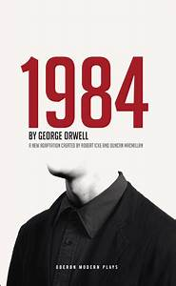
It was a bright cold day in April, and the clocks were striking thirteen.
~George Orwell,
1984
Notes:
Reflects theme? Promise of emotion? Microtension? Mirrors the ending? Opens New World?

Slide 22
How to build a Hook:
WORLD BUILDING via:
Visceral Details
Evocative Details
Telling Details

Slide 23
Visceral details:
revealing the POV character's emotions.

Slide 24
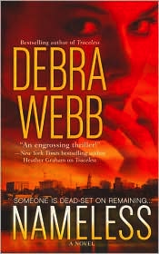
Waking up dead would have been preferable to waking up with this screaming throb inside his skull.
~Debra Webb, NAMELESS
Notes:
Got some idea what this pov character is feeling? No lack of visceral details here!

Slide 25
Evocative details:
Eliciting emotion
in your reader.
Notes:
It’s not enough to reveal your character’s emotions. You need to also evoke emotion from your reader.Make them care about your world and your characters. Evocative details create atmosphere, setting, tone. How a writer uses evocative details is often a large part of their voice.

Slide 26
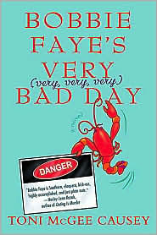
Something wet and spongy plunked against Bobbie Faye's face and she sprang awake, arms pinwheeling.
~Toni McGee Causey
Bobbie Faye's Very (very, very, very) Bad Day
Notes:
Did this make you smile? Do you think this is going to be a fun read? What does this opening tell you about the writer's voice? How many of you guys have used the word Plunked???

Slide 27
Telling details:
Every single detail you choose must do the work of creating an universe for the reader.
Notes:
Telling details are the brick and mortar that you create your fictional world with. These choices, what to include, which words to use, are vital to pulling the reader in and to creating the lightning fast pace that thrillers are known for. These details allow the reader to suspend belief and to follow wherever you lead them.

Slide 28
The last time Dr. Cassandra Hart entered Pittsburgh’s Three Rivers Medical Center’s ER she was covered in the blood of the man she had killed.
~CJ Lyons
SLEIGHT OF HAND
Notes:
Reflects theme? How to forgive ourself when we’ve done the unforgivable?
Promise of emotion? Microtension? Mirrors the ending? Opens New World?

Slide 29
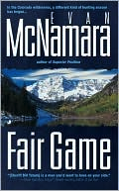
Ever since we shot half of the Mineral County sheriff's department, my deputy and I have been a little shorthanded.
~Evan McNamara
FAIR GAME
Notes:
This passage combines all three: visceral, evocative, telling. It definitely is visceral--revealing the pov char's laconic style.
What kind of emotion do you feel? Are you intrigued? Want to know why the sheriff shot half his men?
And how about those telling details: We're in Mineral County--small town where real laws might not apply, we have a sherriff and deputy, and "we" shot half of the rest of the department. Why only half and not all? How his deputy feels about him now? Do you want to read on, are you hooked?
Reflects theme? Promise of emotion? Microtension? Mirrors the ending? Opens New World?

Slide 30
YOUR TURN!
Notes:
Take a look at your opening first line, a few mins to tweak, share and analyze...

Slide 32
STRONG CHARACTERS
CJ Lyons
Thrillers with Heart®
CJLyons.net

Slide 33
What is Story?
Characters
Taking
Action
Notes:
BUT…how do we know WHAT actions/decisions they choose?
How do any of us make decisions? We LEARN what works for us over time from our past experiences, AKA....

Slide 34
The DREADED BACKSTORY

Slide 35
Look to the PAST:
Values = taught at early age
Beliefs = learned from world around them via their experiences (right or wrong)
Trauma
=> Add up to Motivation/Default Action/WHY
Notes:
Psychic wound, misbelief, unconscious need, greatest fear…our past informs our present and future and gives you bookends for the plot and character arc
If know Default and why it came to be, also know how to best challenge characters and what end of book must be to reflect character learning a NEW way to deal with world

Slide 36
What do they NEED to LEARN?
Notes:
Inner goals are often unconscious, revealed to the reader by the character's actions although the character may never become aware of them.
And relearning how you’ve lived your entire life is not going to be simple—you will need to take them to hell and back, force them to face their greatest fears and learn more about their own secrets than ANYONE would ever want to

Slide 37
PAST is…
Motivation/WHY
Source of Default Action
Forms greatest fears
Inspires character’s inner NEED

Slide 38
FUTURE is…
Outer Goal: what they WANT
Inner Goal: what they NEED
Notes:
Goals reflect the resolution of the book, represent the future of the character. Just as motivation emerges from their past.
And, just like in real life, if you know WHY a person wants something (their motivation) and WHAT they want (their goals), then you can often understand HOW they're going to get into trouble as they try to achieve their goals.

Slide 39
PRESENT is…
HOW they get what they Want/Need
Filled with CONFLICT, conflict, conflict
Decisions, dilemmas, dire straits
Notes:
Leading to the ninety percent or more of the book that is in the present, the here and now. This is the character's flesh and bones, their chance to really come to life.
How? By revealing their choices. Their actions. Their decisions. Their sacrifices.

Slide 40
NO conflict = NO story
Notes:
Conflict means placing characters under pressure and forcing them to take action.
From their actions we learn about them, we begin to identify with them, we even start to care—not only whether they win or lose, but about what happens to them, we want to feel them living beyond the confines of the pages of the book.
Each and every decision—from what your character eats, wears or who they chose to associate with, their living arrangements, the car they drive, the job they do—all of these reveal character

Slide 41
CONFLICT
Outer Conflict = Nemesis, what most stands in way of obtaining story Goal
Inner Conflict = greatest FEAR
Notes:
Outer conflict is from external events: forces of nature, solving a mystery, making a journey.
Inner conflict is from inner turmoil: doubts, fears, anxieties, fears. Did I mention fear? Knowing your characters' secret, hidden fears and forcing them to face them in different situations will add structure and resonance to your plot.

Slide 42
Notes:
Combine inner conflict/fears with theme and get one-two punch

Slide 43
Finding your DEFAULT
Childhood trauma
Teaches an attitude to protect character
Okay if “cliché” : lone wolf cop, Scrooge, Blanche Dubois, etc
Notes:
Where do we learn our default action? When is that psychic wound created or that misbelief established so firmly it changes how we react to everything for the rest of our lives (or at least until we’re tested in a story)?
For instance, any character whose mantra (or attitude) is: if it ain't broke, don't fix it is going to react in a very different way to unexpected change than one whose mantra is: variety is the spice of life.

Slide 44
Character is Plot
Act One = Past/World of Default Working
Act Two = Present/Upside Down/Default NOT Working/Conflict
Act Three = Future/Goals Won or Lost or Sacrificed/NEW Default Created

Slide 45
SILENCE OF THE LAMBS
Outer Goal = WANTs to save girl
Inner Goal = NEEDs to…
Notes:
Inner Goals are often shades of grey, but should have some tangible element that a reader can cling to, to allow the reader to feel satisfied that the character has achieved their Inner Goal. They’re tied to the character’s Default as well as their greatest Fear, which they created their Default to guard against.

Slide 46
SILENCE OF THE LAMBS
Outer Goal = WANTs to save girl
Inner Goal = NEEDs to…
SILENCE THE LAMBS
Notes:
In Silence of the Lambs, Clarice's unconscious desire, hidden need, Inner Goal, is to face her fears of abandonment caused by her father's death and what happened on her uncle's farm. It's subtle—she doesn't recognize this need until near the end of the book, and yet Harris clearly planned this additional depth very carefully.
He even named the book after it. Genius!
Clarice has no idea what the title of the book is, but the reader does.

Slide 47
Outer Conflict = Buffalo Bill
Inner Conflict/Greatest Fear = being abandoned/helpless to save anyone especially herself
Set up in Act Two but comes true in Act Three
Notes:
Clarice's greatest fear is of being abandoned, of being alone and unable to survive or save anything—not even a little lamb.

Slide 48
Past => Present => Future
Childhood Trauma = loss of father/unable to save lambs
Leads to DEFAULT of going it alone (if alone can’t be abandoned)
UNTIL Act 3 Black Moment when faces FEARS and learns NEW Default
Notes:
Her Default Action is to go it alone so she can be in control. Why? because her greatest fear is being abandoned, helpless, so she's forged a life where her Default Action, is her greatest strength…until the Black Moment when she discovers it's also her greatest weakness.
childhood trauma led to her developing a Default of never allowing an innocent to suffer harm if she can help it—even if it means risking her life, her career, everything.
And how does Harris use this in the book? She's abandoned by the FBI, alone in the dark with a killer stalking her and the life of an innocent in her hands. Facing her greatest fear. Once she conquers it, that unconscious need is satisfied. She can now move forward, a better person, someone now ready to become the leader she’s destined to be.

Slide 49
Childhood FEAR
+
Protective DEFAULT
+
Unconscious NEED
=> ALL intersect at Black Moment
Notes:
The Need is tied to the character's greatest Fear, which they created their Default to protect them from facing. These intersect at the moment when the character faces this fear head-on as the worst thing that could ever, ever happen to them….called the Black Moment of the story's Act Three.
Immediately following this Black Moment comes the Climax where the character either succeeds or fails in their Outer Goal—based on whether or not they were successful in overcoming their fear and changing.
In other words, the plot and pacing are tied to the character's Want. AND, if you also give your character an Inner Goal, that Need should also be resolved during the scenes surrounding the climax.

Slide 50
Go Primal
Protagonist
Antagonist v. Nemesis
Romantic Interest
Shapeshifter/Trickster
Mentor
Sidekicks
Red Shirts
Notes:
Archetypes are universal shorthand—create instant recognition in reader…but just like all seeds might look alike, they don’t sprout into the same plant…twist and spin, surprise and delight…
Antagonist blocks MC’s path but is reasonable, potential for change (many romantic interests are also Antagonists)
Nemesis are fixated, obsessed and let nothing stand in their way

Slide 51
Your Turn:
Who is your main character?
Do they have a Antagonist?
Do they have a Nemesis?
Do they have a Love Interest?
Do they have a Mentor?
Is anyone a Shapeshifter/Trickster?
Is there a Sidekick?
Notes:
Combine with your central story idea and theme to brainstorm scenes that are necessary to illustrate the main character’s progress toward both their story goal and their inner change as they sacrifice their original default for a new one.
For main characters, especially protag/antag/nemesis be sure to understand their Default, Fears, and Goals

Slide 52
What’s your main character’s DEFAULT?
What past trauma led to it?
What’s their greatest FEAR?
What do they NEED to learn to overcome this fear/create a new Default?
What is their Story Goal/WANT?
Who/what most stands in their way?
Bonus: what’s your THEME?
Notes:
Don’t share but keep to build on

